Slide 1
OneTick Training
JOIN and MERGE Eps
Advanced

Slide 2

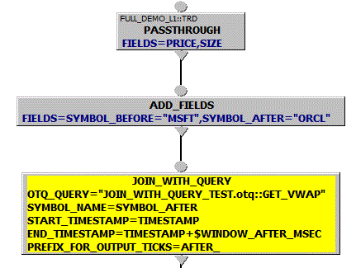
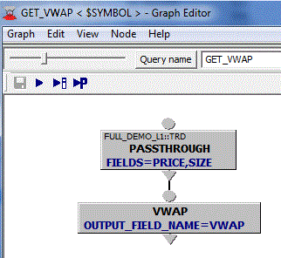
JOIN_WITH_QUERY
Joins every input tick with the resulting ticks of a query, executed upon the arrival of that tick
The query name as well as query parameters are subject to being reevaluated dynamically each time an input tick arrives
Example: GET_VWAP query is evaluated for SYMBOL_NAME= “ORCL” on each input IBM TRD tick.

Slide 3
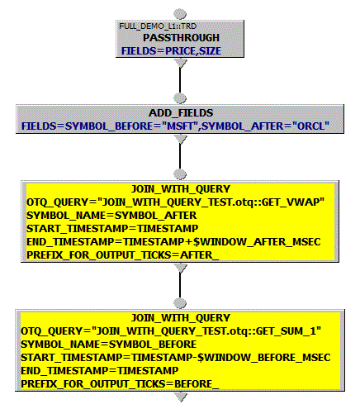
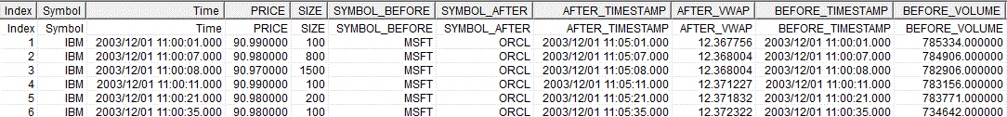
JOIN_WITH_QUERY (cont.)
Example: Get statistics for other symbols for the periods of time right BEFORE and right AFTER the main symbol (IBM) trade. Once all values are available for each tick one can calculate correlation, etc.

Slide 4
OneTick Training
Merge and bound symbol lists
Used when you want to calculate metrics across symbols.

Slide 5
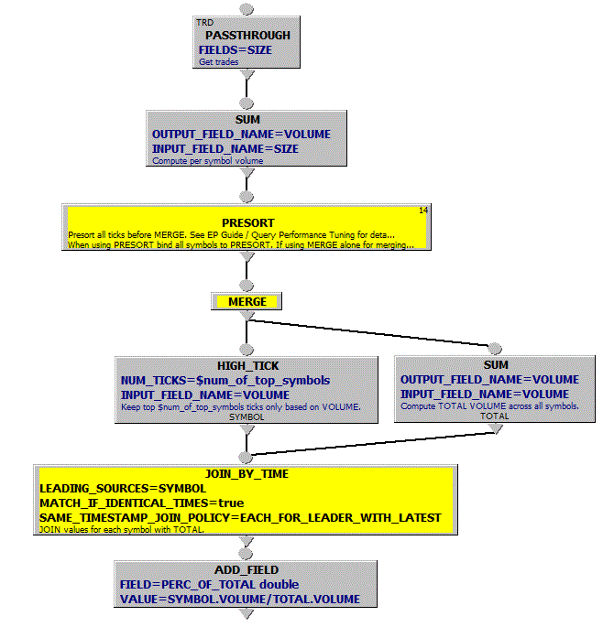
MERGE
Per
Symbol
Example:
Top Market Players
Merge daily volumes for a list of symbols into 1 time series to output top 5 volumes. Show what percent these volumes represent of the overall daily total volume.
MERGE
Across
Symbols
Note: See EP Guide / Query Performance Tuning on the details of using PRESORT EP with MERGE.

Slide 6
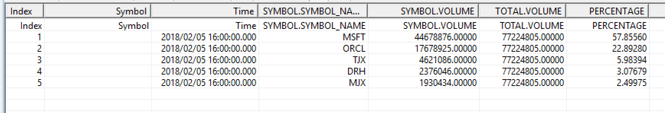
MERGE
Per
Symbol
Example:
Top Market Players
Query output:
MERGE
Notes: Binding symbols to MERGE or PRESORT followed by MERGE merges all time series into 1 based on timestamps and omdseq (if available)
Across
Symbols

Slide 7
MERGE
Per
Symbol
Example:
Top Market Players
Query output:
MERGE
Notes: Everything above the merge is done on a per symbol basis. The results for all symbols are then merged.
Across
Symbols

Slide 8
MERGE
Per
Symbol
Example:
Top Market Players
Query output:
MERGE
Notes: PRESORT speeds things up if the per-symbol bit of the query greatly reduces the number of ticks (e.g. by aggregation, as here). It also allows more control over parallelisation.
Across
Symbols

Slide 9
Multistage queries and CEP.
Dynamic Symbol lists.
Symbol lists retrieved via CSV_FILE_LISTING and FIND_DB_SYMBOLS can be changed during a CEP query to add or remove symbols or modify symbol parameters.
This requires some special parameters in the eval() function that retrieves the symbol list (_CONTINUOUS and _OUTPUT_DBS) and has a few other differences to static symbol lists.
This is all documented in:
Help->Event Processor Guide ->Multistage Queries

Slide 10
Multistage queries and CEP.
Dynamic Symbol lists.
Symbol lists retrieved via CSV_FILE_LISTING and FIND_DB_SYMBOLS can be changed during a CEP query to add or remove symbols or modify symbol parameters.
This requires some special parameters in the eval() function that retrieves the symbol list (_CONTINUOUS and _OUTPUT_DBS) and has a few other differences to static symbol lists.
This is all documented in:
Help->Event Processor Guide ->Multistage Queries
Dynamic symbol lists cannot be used for bound symbols….

Slide 11
Multistage queries and CEP.
Dynamic symbol lists cannot be used for bound symbols. But the new (Mar 2018) MERGE_NONBOUND_SYMBOLS EP overcomes this limitation.
This has some limitations.
All output ticks are changed to have a timestamp of the current time.
For any historic part of the query symbols are processed sequentially, so original arrival order is not maintained.
But for use cases where only the current state is of interest this is acceptable.
Here’s an example showing how historic data is output:
Notes:
Actual use case that provoked this EP: Realtime client exposure monitoring. DB is keyed by OrderId. To calculated exposure need to sum exposure/order across order grouped by Clie
ntId.

